Slide 1

A Study on the Improvement of GPS Positioning Accuracy Based on the Least Squares Method
Group Member: Wang Mingchen、He Jianlang、Liu Qingyuan、
Chen Jiamin、Liang Jiahui
Notes:
Good afternoon everyone. My name is Liang Jiahui. Today I am going to talk about a study on the improvement of GPS positioning accuracy based on the least squares method. And our group members are Wang Mingchen、He Jianlang、Liu Qingyuan、Chen Jiamin and me.

Slide 2

Contents
目錄
01
Experimental Principle
02
Experimental Procedure
03
Problem Analysis and Improvement
Notes:
I gonna to talk about three parts. The first part is experimental principle. The second part is experimental procedure. and the third part is problem analysis and improvement.

Slide 3
Experimental Principle
01

Slide 4
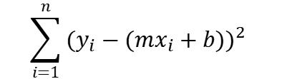
Experimental Principle
1) Least Squares Method
Y
A mathematical optimization modeling method
It finds the best function match for the data by minimizing the sum of squares of the errors.
$$\sum_{i=1}^{n}{{(y_{i}−(mx_{i}+b))}^{2} }$$
X
Notes:
Least squares plays an important role in data fitting and least square problems. By minimizing the sum of squares of the residuals between observations and model predictions, least squares is able to find the optimal model parameters. In the figure on the right, we can clearly see the idea of the least squares method: it works to find an estimation curve that makes it possible to run through each observation $(x_{i},y_{i})$ and minimize the sum of the squares of the distances from the observations to that curve.
One of the strengths of the least squares method lies in its intuitive nature and ease of understanding. It provides an intuitive way to solve the data fitting problem by minimizing the sum of squared residuals to find the optimal fitting curve. Secondly, the least squares method is linear and unbiased, and is capable of obtaining a uniform optimal solution. In addition, the least squares method is robust to random errors in the data, so its parameter estimation is relatively stable in the face of noisy real data.

Slide 5
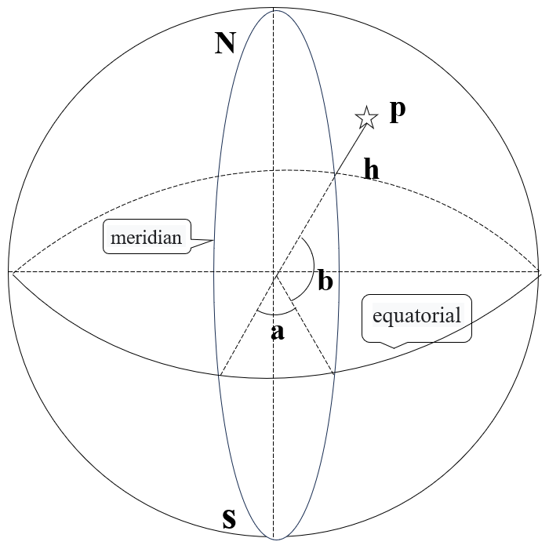
Experimental Principle
2) Conversion between ECFF and Geodetic Coordinate Systems
01
A system of coordinates used to describe the position of a point on the Earth's surface
02
Longitude: represents the angular difference between a point and the prime meridian
03
Latitude: represents the angular difference between a point and the Earth's equator
Geodetic coordinates system
Notes:
LLA is an acronym for Longitude, Latitude and Altitude. It is a system of geographic coordinates used to describe locations on the Earth's surface. Longitude indicates the location of a point in the east-west direction, latitude indicates the location of a point in the north-south direction, and altitude indicates the height of the point relative to sea level.
However, despite the intuitive simplicity of the LLA coordinate system, in some fields, such as spatial computing and navigation systems, it is common to convert LLA coordinates to ECEF coordinates in order to make the math easier.

Slide 6
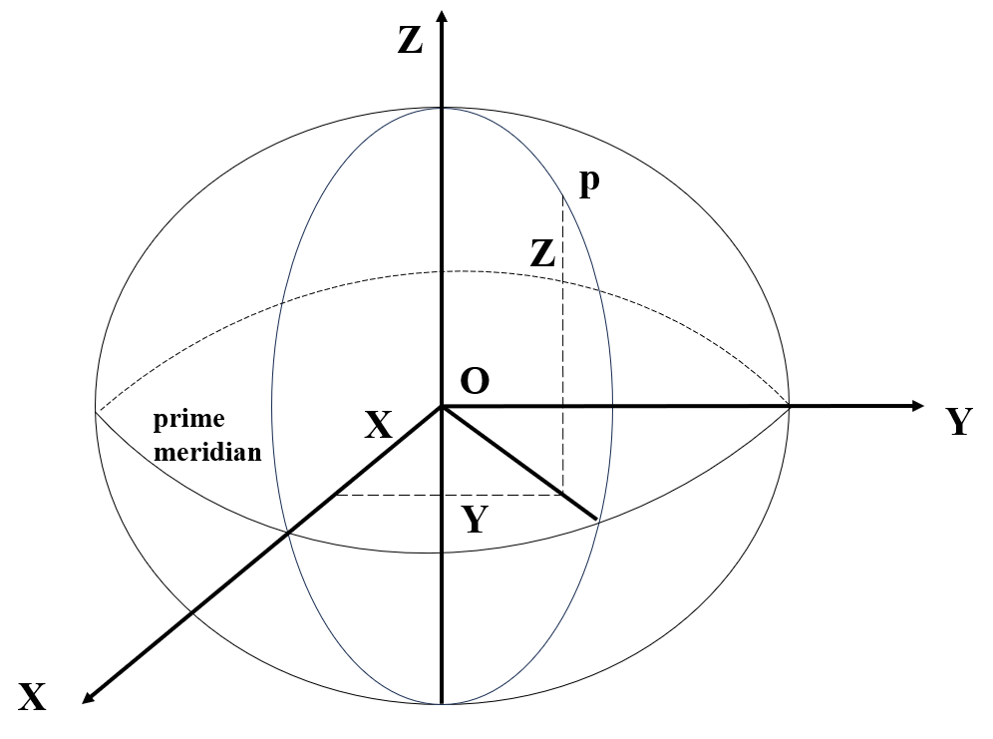
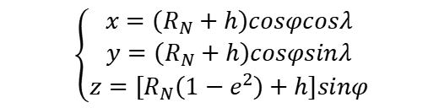
Experimental Principle
2) Conversion between ECFF and Geodetic Coordinate Systems
The geocentric earth solid coordinate system (ECEF) is a right-angle coordinate system with the Earth's center of mass as the origin and the Earth's rotation axis as the Z axis.
It describes the three-dimensional position of a point on Earth by converting latitude and longitude (LLA) coordinates to the distance of a point on Earth in the X, Y, and Z directions.
ECEF Coordinate System
$$\begin{aligned}&\left\{\begin{aligned}&x=\left(R_{N}+h\right)cosφcosλ \\ &y=\left(R_{N}+h\right)cosφsinλ \\ &z=\left[R_{N}\left(1−e^{2}\right)+h\right]sinφ\end{aligned}\right.\end{aligned}$$
Notes:
The ECEF (Earth-Centered, Earth-Fixed) coordinate system is a geocentric geoidal coordinate system for describing positions on Earth. Where the center of the Earth is defined as the origin and the direction of the Earth's rotation axis is defined as the Z-axis of the coordinate system.
The ECEF coordinate system uses three coordinate values (X, Y, and Z) to describe the location of points on Earth. These coordinate values represent the straight-line distance of the point from the center of the Earth, usually in meters. Specifically, the X-axis points to a location with a longitude of 0°, the Y-axis points to a location with a longitude of 90°, and the Z-axis points to the North Pole, with a positive orientation to the Northern Hemisphere. Thus, the position of each point can be determined by its linear distance from the center of the Earth and its angle to the axis.
In the field of navigation, the ECEF coordinate system provides an ideal coordinate reference for satellite navigation systems such as GPS.

Slide 7
Experimental Procedure
02

Slide 8





Data Collection
Interpreter
Console
QPython
Editor
Scripting Layer for Android (SL4A)
Notes:
In order to collect GPS data from real-time location of Android mobile phones, for the application we used QPython.The application is an application for running Python scripts on Android devices. It contains Python interpreter, console, editor and Scripting Layer for Android (SL4A) and supports many common Python libraries and modules, enabling users to write and run Python code on mobile devices.QPython is divided into QPython2 and QPython3, they are based on Python2 and Python3 respectively, we are using Python3.

Slide 9

Data Collection
The AndroidHelper library is used for data collection, which is a wrapper around SL4A, the same as the Android Scripting Environment (ASE).
SL4A brings a scripting language to Android, allowing users to edit and execute scripts, and is an interactive interpreter that can be run directly on Android devices.
Notes:
The AndroidHelper library is used for data collection, which is a wrapper for SL4A.SL4A has the same meaning as Android Scripting Environment (ASE).According to Google's official introduction, SL4A brings a scripting language to Android, allowing users to edit and execute scripts, and is an interactive interpreter that can be run directly on Android devices.

Slide 10
Data Collection
startLocating()
minDistance=1000
minUpdateDistance=0
readLocation()
network
GPS
...
Sleep for 5 seconds
altitude
latitude
longitude
accuracy
...
stopLocating()
Notes:
Firstly, create an instance, call startLocating function to start collecting the location data and set the minimum time between updates minDistance (in milliseconds) to 1000, which is 1 second.
Because our mobile device is stationary while collecting data, to collect valid data we set the minimum distance between updates minUpdateDistance (in metres) to 0. Then we call the readLocation function to get the location data, which returns a dictionary that on our mobile device contains data from two different providers: network, location information provided by gps, in some devices there may be a third provider: passive, here we need the GPS data.
The fields included in the GPS data are: altitude, latitude, longitude, accuracy, time, speed, provider, and bearing. The data we use here are altitude, latitude, longitude and accuracy. Among them, accuracy indicates the precision of the location information, i.e. the error between the location and the actual location, usually in metres. Usually, a lower accuracy value means that the location information is more accurate. At the same time, we set a sleep time of 5 seconds, i.e., we collect data every 5 seconds. After the data is collected, the stopLocating function is used to stop the location.

Slide 11
Data Collection
Data samples:
altitude | latitude | longitude | accuracy
14.54316941 | 22.13813039 | 113.5386591 | 52.13176346
14.54316941 | 22.13813039 | 113.5386591 | 52.13176346
109.3420698 | 22.13774611 | 113.5379759 | 4.900000095
100.9733335 | 22.13774571 | 113.5379506 | 4.900000095
... | ... | ... | ...
Notes:
Below is a sample of the data we collected, you can see that even if the mobile phone device is stationary, the data collected can be very different, for example, altitude, it is clear that the first 2 data have a larger accuracy, and what we want to do is to reduce the accuracy.

Slide 12
Data Processing
Numeric Conversion
Conversion between ECEF and geodetic coordinate systems
Numerical standardisation
De-duplication
Min-max Normalization
Retain valid and unduplicated data for use
Notes:
During the experiment, as GPS positioning involves different physical quantities such as distance, speed, time, etc., they may have different magnitudes (units). In order to carry out effective calculations and data processing, these quantities need to be appropriately processed and standardized. Duplicate rows of data are first de-duplicated and valid and non-duplicated data are retained for use. The data are then converted between the ECEF and geodetic coordinate systems and processed for polygonal positioning data. The following is a detailed description of the conversion between ECEF and geodetic coordinate systems and the processing of polygonal positioning data.

Slide 13
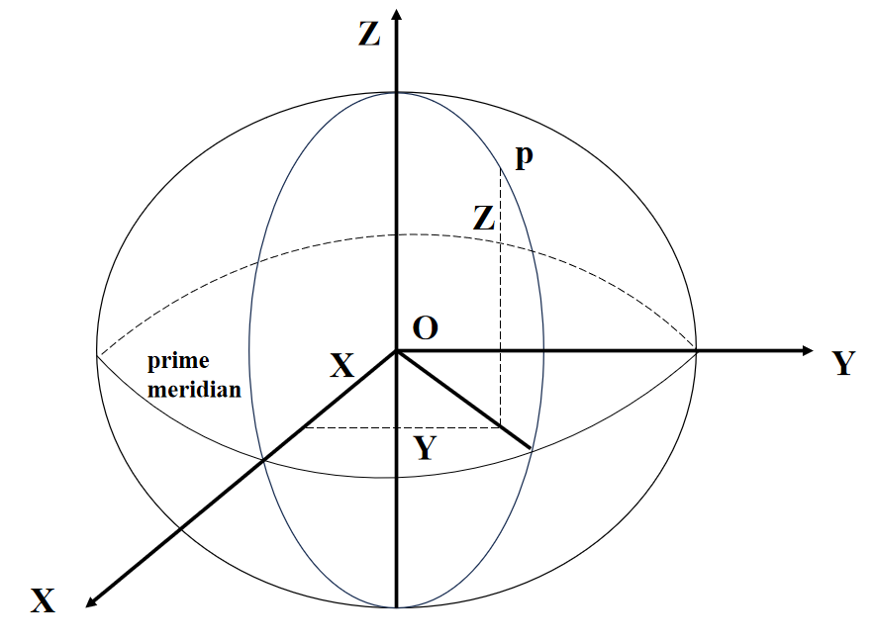
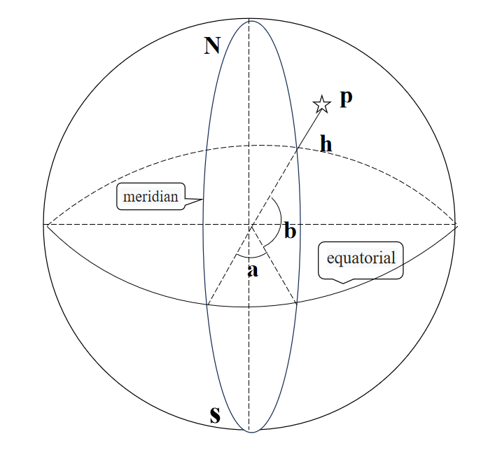
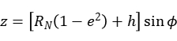
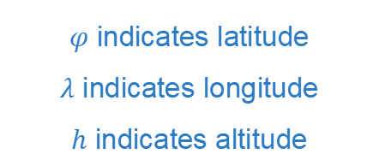
Data Processing——Numeric Conversion
Coordinates of the geodetic coordinate system
ECEF coordinate system
Value of Longitude
$φ$ indicates latitude
$λ$ indicates longitude
$h$ indicates altitude
Value of Latitude
Value of Altitude
Notes:
Since the collected positioning data are the values of Longitude, Latitude and Altitude where the cell phone device is located at a certain moment, which are the coordinates of the geodetic coordinate system used by the people, while the satellite's position as well as the user's position are represented in the ECEF coordinate system during the receiver positioning solution. Therefore, it is necessary to realize the conversion between the ECEF coordinate system and the geodetic coordinate system. According to the literature, we can convert from geodetic coordinate system to ECEF by the following relationship:
where $φ$ denotes latitude, $λ$ denotes longitude, and $h$ denotes elevation.

Slide 14
Data Processing——Numeric Standardisation
Min-max Normalization：Scale a set of coordinate values into the interval [0,1]
01
Used in application scenarios such as data normalisation and feature scaling
02
Ensure comparability between different coordinate values
03
Improving model performance
Notes:
In addition, since we will deal with polygonal localization later, we need to unify the magnitudes so that we can simplify the computation and reduce rounding errors in floating-point arithmetic. The method we use is min-max normalization, which usually means scaling a set of coordinate values to the interval [0,1] when performing max-min normalization of coordinates. This treatment is commonly used in application scenarios such as data normalization and feature scaling, which ensures comparability between different coordinate values and helps to improve the performance of the model.

Slide 15
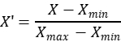
Data Processing——Numerical Standardisation
Iterate through all the coordinate value
Find the respective maximum and minimum values
Values of Min-max: Original Coordinates
Improve the interpretability of the model to ensure that the model is solved without singular matrices
Maximising and minimising the coordinates allows for better interpretability of the model's coefficients or weights
Notes:
The specific formula is shown in the figure.
It actually iterates over all the coordinate values to find the respective maximum and minimum values. The maximum value represents the maximum value in the original coordinates and the minimum value represents the minimum value in the original coordinates. This is so that the interpretability of the model can be improved and to ensure that the model is not solved with singular matrices. For example, when the range of values of the coordinates is very large, the coefficients or weights of the model may become very small and difficult to interpret intuitively. By maximally minimizing the coordinates, it allows for better interpretability of the model's coefficients or weights.

Slide 16
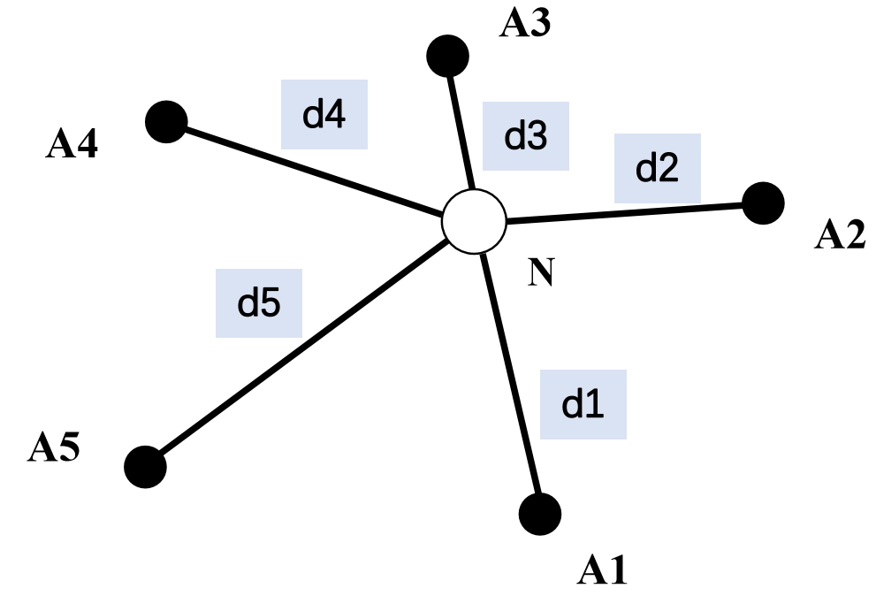
Modelling and solving
Measuring the distance or direction between multiple points and the target
Determining the position of the target from these measurements
Widely used in geographic surveying, navigation systems
Principle: Using the properties of geometric triangles
Advantage: Determination of target location without a priori information
Multilateral Positioning Schematic
Notes:
A mathematical model of the satellite navigation system is developed based on the coordinates of the collected data.
Firstly, we solve it based on such a multilateral positioning schematic.
And why we will choose polygonal positioning solution, first of all, polygonal positioning is a method based on measuring the distance or direction between multiple points and a target, and determining the position of the target by these measurements. It is a commonly used positioning technique and is widely used in geographic surveying, navigation systems (e.g., GPS), and other fields where the position of an object needs to be determined.
And it is based on the principle of using the nature of geometric triangles to calculate the position of the target point by measuring the distance or direction between multiple points of known position and the target point. In two-dimensional space, at least three known points with the distance or direction information of the target point are needed; in three-dimensional space, at least four known points with the distance or direction information of the target point are needed.
Because it has the advantage of being able to determine the target position without a priori information, only the distance or direction between the point and the target needs to be measured, we use it for the solution.

Slide 17
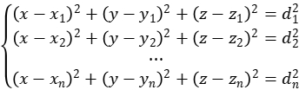
Modelling and solving——Least Squares
1) System of Representation Equations with Unknown Parameters:
denotes the distance between the point to be predicted and the detected point.
Notes:
Suppose the point to be determined is (x,y,z), which is infinitely close to where we really are. According to the formula for the distance between points, the resulting system of representation equations is as follows:
Where, di(i=1,2,3) denotes the distance between the point to be predicted and the detected point. Here the accuracy field in the data is used as d.

Slide 18
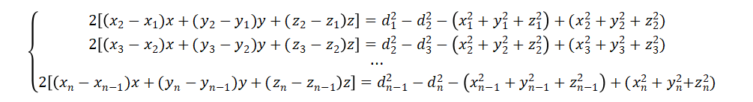
Modelling and solving——Least Squares
Achieve elimination of the square power of the positional parameter in the system of equations $x^{2}+y^{2}+z^{2}$：
Notes:
Based on the above system of equations, the first equation is subtracted from the second equation, the second equation is subtracted from the third equation, and so on, to achieve the elimination of the square power of the positional parameter in the system of equations $x^{2}+y^{2}+z^{2}$

Slide 19
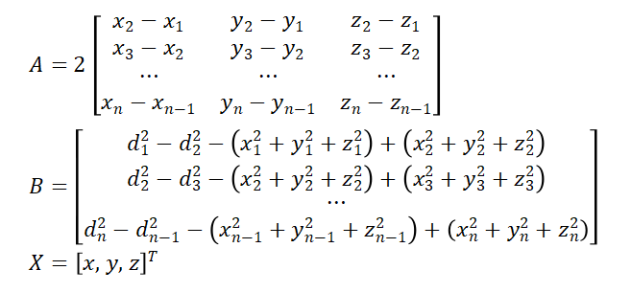
Modelling and solving——Least Squares
The matrix representation of this system of equations takes the form: $AX=B$
Notes:
The matrix representation of this system of equations is shown in the figure

Slide 20
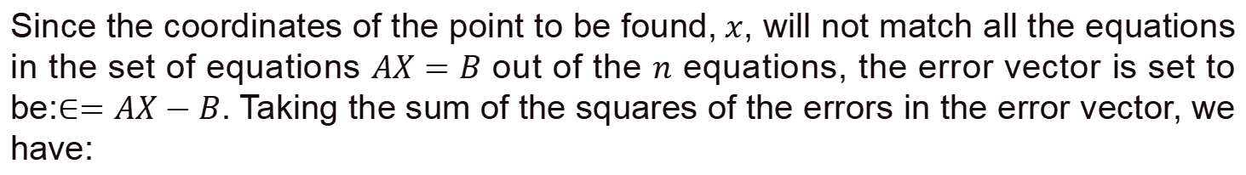
Modelling and solving——Least Squares
2) Definition Error:
Since the coordinates of the point to be found,$x$, will not match all the equations in the set of equations $AX=B$ out of the $n$ equations, the error vector is set to be:$∈=AX−B$. Taking the sum of the squares of the errors in the error vector, we have:
$$E={\left|∈\right|}^{2}=∈^{T}∈={\left(AX−B\right)}^{T}\left(AX−B\right)$$
Notes:
Since the coordinates of the point to be found,$x$, will not match all the equations in the set of equations $AX=B$ out of the $n$ equations, the error vector is set to be:$∈=AX−B$. Taking the sum of the squares of the errors in the error vector, we have this formula.

Slide 21
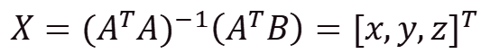
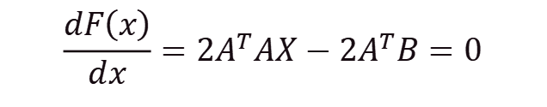
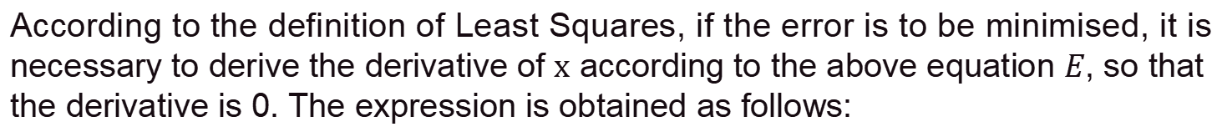
Modelling and solving——Least Squares
3) Solve using the Least Squares method:
According to the definition of Least Squares, if the error is to be minimised, it is necessary to derive the derivative of $x$ according to the above equation $E$, so that the derivative is 0. The expression is obtained as follows:
$$\frac{dF\left(x\right)}{dx}=2A^{T}AX−2A^{T}B=0$$
Solve to get :
$$X={(A^{T}A)}^{−1}\left(A^{T}B\right)={[x,y,z]}^{T}$$
Notes:
Thus the coordinates of the point to be determined can be obtained: (x,y,z). Subsequently, based on the information from the data preprocessing, the solution results are inverse normalised and reduced to obtain the real ECEF coordinates, which are finally converted into latitude, longitude and altitude.

Slide 22
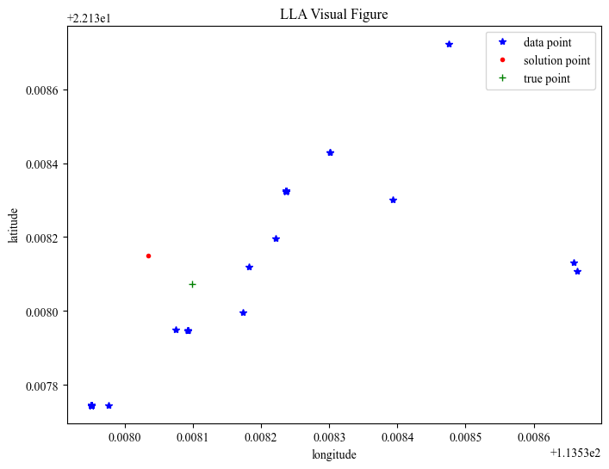
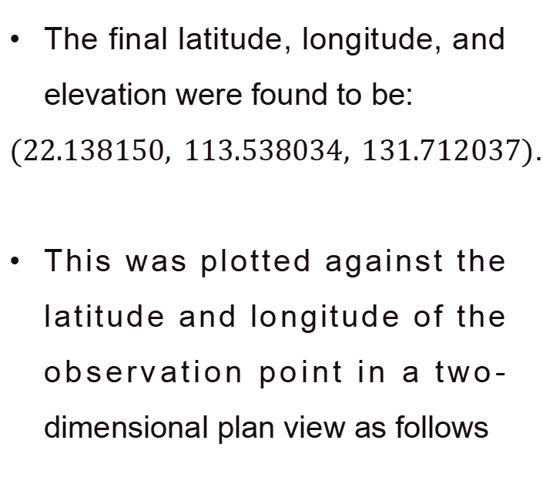
Modelling and solving——Least Squares
The final latitude, longitude, and elevation were found to be:
$(22.138150, 113.538034, 131.712037)$.
This was plotted against the latitude and longitude of the observation point in a two-dimensional plan view as follows
Notes:
Thus the coordinates of the point to be determined can be obtained: (x,y,z). Subsequently, according to the information of data preprocessing, the solution results are inverse normalized and reduced to get the real ECEF coordinates, which are finally converted into latitude, longitude and altitude.
The final latitude, longitude, and elevation were obtained as: $(22.138150, 113.538034, 131.712037)$. It was plotted with the latitude and longitude of the observation point into a two-dimensional plan as follows:

Slide 23
Problem Analysis and Improvement
03
Notes:
The third part is Problem Analysis and Improvement

Slide 24
Problem Analysis and Improvement
01
Redefining the coordinate system
02
Numerical standardization
Normalize transformed 3D coordinates and distances using Min-Max normalization
Converting 2D coordinates to 3D coordinates
03
Lack of additional reliable data sources
Exploring the authenticity of accuracy data
04
Inability to derive more detailed data such as pseudo-distance, clock deviation, etc.
Explore whether it is a straight line distance between the observed and real point or a surface distance
Notes:
1、At first, when collecting the demo data, the available data obtained after de-weighting were 4 observation points with the same elevation, and at the beginning, the elevation was eliminated and only the latitude and longitude were used for the experiments, and the latitude and longitude were only converted into two-dimensional coordinates, and the final results obtained were close to the real location under the ideal case of the plane. Therefore, we subsequently re-collected the data and obtained several data with different elevation, longitude, latitude and close to the real location, and consulted the information and used the right hand three-dimensional coordinate system of ECEF's ellipsoid model to convert latitude, longitude and elevation to three-dimensional coordinates, which helped us to complete the experiment.
2、After the latitude and longitude converted into three-dimensional coordinates, the results of using the least squares method of solving is not particularly ideal, the predicted coordinates are even longer than the distance of the observation point, so the Min-Max standardization is introduced here to standardize the converted three-dimensional coordinates and distances, and ultimately the coordinates of the point to be determined are closer to the real coordinates.
3、In this experiment, the data we collected lacked information from GPS satellites, so we were unable to derive more detailed data such as pseudo-distance, clock deviation, etc., and thus lacked more reliable data sources for the final least squares solution.
For subsequent improvement, Global Navigation Satellite System (GNSS) receiving equipment is required. By setting up the GNSS receiving equipment for data collection, collecting data at the appropriate location and time, recording and storing the collected data in the appropriate data format, and post-processing and analyzing the collected data, the data can be improved. and thus refining the data.
4、In the collected data, the authenticity of the column of accuracy has to be examined, whether it describes the straight line distance between the observation point and the real point or the distance to the surface, and whether the direct use of the data without conversion may cause errors in the final results.
Since the Earth is an ellipsoid rather than a plane, there is a difference between straight-line distances and surface distances. At longer distances and at higher latitudes, this difference may become more significant. If accurate surface distance data are required, more sophisticated measurements and computational methods, such as differential GPS or correlation calculations using Earth models, may be necessary.

Slide 25
Thank you for listening
Group Member: Wang Mingchen、He Jianlang、Liu Qingyuan、
Chen Jiamin、Liang Jiahui

